Slide 1
SYED HASAN SAEED
Email: hasansaeedcontrol@gmail.com
Web Page: hasansaeed872726549.wordpress.com
shasansaeed.yolasite.com

Slide 2
BOOKS
AUTOMATIC CONTROL SYSTEM: KUO & GOLANARAGHI
2. CONTROL SYSTEM: ANAND KUMAR
3. AUTOMATIC CONTROL SYSTEM: S. HASAN SAEED
ELECTRICAL MACINE & AUTOMATIC CONTROL: J.B.GUPTA & S. HASAN SAEED
AUTOMATIC CONTROL SYSTEM: R. A . BARAPATE

Slide 3
OUTLINE
Definition of Transfer Function.
Poles & Zeros.
Characteristic Equation.
Advantages of Transfer Function.
Mechanical System (i) Translational System and (ii) Rotational System.
Free Body diagram.
Transfer Function of Electrical, Mechanical Systems.
D’Alembert Principle.

Slide 4
TRANSFER FUNCTION
Definition: The transfer function is defined as the ratio of Laplace transform of the output to the Laplace transform of input with all initial conditions are zero.
We can define the transfer function as
In equation (1.0), if the order of the denominator polynomial is greater than the order of the numerator polynomial then the transfer function is said to be STRICTLY PROPER. If the order of both polynomials are same, then the transfer function is PROPER. The transfer function is said to be IMPROPER, if the order of numerator polynomial is greater than the order of the denominator polynomial.

Slide 5
CHARACTERISTIC EQUATION: The characteristic equation can be obtained by equating the denominator polynomial of the transfer function to zero. That is

Slide 6
POLES AND ZEROS OF A TRANSFER FUNCTION
POLES : The poles of G(s) are those values of ‘s’ which make G(s) tend to infinity.
ZEROS: The zeros of G(s) are those values of ‘s’ which make G(s) tend to zero.
If either poles or zeros coincide, then such type of poles or zeros are called multiple poles or zeros, otherwise they are known as simple poles or zeros.
For example, consider following transfer function

Slide 7
This transfer function having the simple poles at s=0, s=-2, multiple poles at s=-4 and simple zero at s=-3.
Advantages of Transfer Function:
Transfer function is a mathematical model of all system components and hence of the overall system and therefore it gives the gain of the system.
Since Laplace transform is used, it converts time domain equations to simple algebraic equations.
With the help of transfer function, poles, zeros and characteristic equation can be determine.
The differential equation of the system can be obtained by replacing ‘s’ with d/dt.

Slide 8
Do not edit How to change the design
The transfer function is defined for
The Slido app must be installed on every computer you’re presenting from

Slide 9
DISADVANTAGES OF TRANSFER FUNCTION:
Transfer function cannot be defined for non-linear system.
From the Transfer function , physical structure of a system cannot determine.
Initial conditions loose their importance.

Slide 10
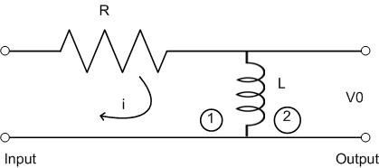
Find the transfer function of the given figure.
Solution:
Step 1: Apply KVL in mesh 1 and mesh 2

Slide 11
Step 2: take Laplace transform of eq. (1) and (2)
Step 3: calculation of transfer function
Equation (5) is the required transfer function

Slide 12
A system having input x(t) and output y(t) is represented by
Equation (1). Find the transfer function of the system.
Solution: taking Laplace transform of equation (1)
G(s) is the required transfer function

Slide 13
The transfer function of the given system is given by
Find the differential equation of the system having input x(t) and output y(t).
Solution:
Taking inverse Laplace transform, we have
Required differential equation is

Slide 14
MECHANICAL SYSTEM
TRANSLATIONAL SYSTEM: The motion takes place along a straight line is known as translational motion. There are three types of forces that resists motion.
INERTIA FORCE: consider a body of mass ‘M’ and acceleration ‘a’, then according to Newton’s law of motion
F_{M}(t)=Ma(t)
If v(t) is the velocity and x(t) is the displacement then
M

Slide 15
DAMPING FORCE: For viscous friction we assume that the damping force is proportional to the velocity.
F_{D}(t)=B v(t)
Where B= Damping Coefficient in N/m/sec.
We can represent ‘B’ by a dashpot consists of piston and cylinder.

Slide 16
SPRING FORCE:A spring stores the potential energy. The restoring force of a spring is proportional to the displacement.
Where ‘K’ is the spring constant or stiffness (N/m)
The stiffness of the spring can be defined as restoring force per unit displacement

Slide 17
ROTATIONAL SYSTEM: The rotational motion of a body can be defined as the motion of a body about a fixed axis. There are three types of torques resists the rotational motion.
Inertia Torque: Inertia(J) is the property of an element that stores the kinetic energy of rotational motion. The inertia torque TI is the product of moment of inertia J and angular acceleration α(t).
Where ω(t) is the angular velocity and θ(t) is the angular displacement.

Slide 18
T_{i} (t)
J
θ(t)
T_{θ} (t)
K
θ(t)

Slide 19
2. Damping torque: The damping torque T_{D}(t) is the product of damping coefficient B and angular velocity ω. Mathematically
3. Spring torque: Spring torque T_{θ}(t) is the product of torsional stiffness and angular displacement.
Unit of ‘K’ is N-m/rad

Slide 20
Do not edit How to change the design
Closed loop transfer function of a control system is
The Slido app must be installed on every computer you’re presenting from

Slide 21
D’ALEMBERT PRINCIPLE
This principle states that “for any body, the algebraic sum of externally applied forces and the forces resisting motion in any given direction is zero”

Slide 22
D’ALEMBERT PRINCIPLE contd……
External Force: F(t)
Resisting Forces :
Inertia Force:
Damping Force:
Spring Force:
K
B
M
X(t)
F(t)

Slide 23
According to D’Alembert Principle

Slide 24
Consider rotational system:
External torque: T(t)
Resisting Torque:
(i) Inertia Torque:
(ii) Damping Torque:
(iii) Spring Torque:
According to D’Alembert Principle:

Slide 25
D'Alembert Principle for rotational motion states that
“For anybody, the algebraic sum of externally applied torques and the torque resisting rotation about any axis is zero.”

Slide 26
Do not edit How to change the design
For anybody, the algebraic sum of externally applied torques and the torque resisting rotation about any axis is constant.
The Slido app must be installed on every computer you’re presenting from

Slide 27
TANSLATIONAL-ROTATIONAL COUNTERPARTS
S.NO. | TRANSLATIONAL | ROTATIONAL
1. | Force, F | Torque, T
2. | Acceleration, a | Angular acceleration, α
3. | Velocity, v | Angular velocity, ω
4. | Displacement, x | Angular displacement, θ
5. | Mass, M | Moment of inertia, J
6. | Damping coefficient, B | Rotational damping coefficient, B
7. | Stiffness | Torsional stiffness

Slide 28
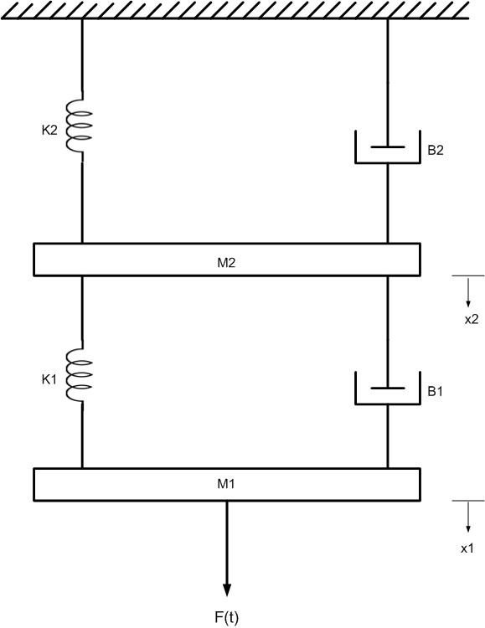
EXAMPLE1: Draw the free body diagram and write the differential equation of the given system shown in fig.
Solution:
Free body diagrams are shown in next slide

Slide 31
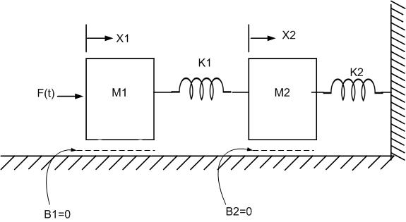
figure
Example 2: Write the differential equations describing the dynamics of the systems shown in figure and find the ratio

Slide 32
FREE BODY DAIGRAMS

Slide 33
Differential equations are

Slide 34
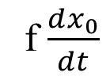
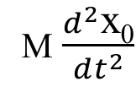
FREE BODY DAIGRAMS
Example 3: Draw the free body diagram of the given system.
F
F
x₀
M
M
M
K
f
M
K x₀
f $\frac{dx_{0}}{dt}$
M $\frac{d^{2}\text{x}\text{0}}{dt^{2}}$

Slide 35
MECHANICAL EQUIVALENT NETWORK
The mechanical equivalent network is useful to determine the transfer function of the system. Following steps are applied to draw the mechanical equivalent network.
STEP 1: Draw a reference line. Consider the fixed points as reference.
STEP 2: Corresponding to the displacement x₁, x₂ ...., select the nodes.
STEP 3: Connect one end of the masses to the reference line.
STEP 4: Connect other elements of the system to the nodes.
STEP 5: Apply nodal analysis, write the equations.

Slide 36
EXAMPLE 4: Consider the fig 1 and draw the mechanical equivalent network and write the equation.
K
B
M
B
K
f(t)
M
Fig. 1
X(t)
Fig.2 Mechanical Equivalent Network
F(t)

Slide 37
EXAMPLE 5: Draw the mechanical equivalent
Network and write the equation fig.(3).
B₁
K₂
B₂
X₁(t)
X₂(t)
M₂
K₁
X₂(t)
M₁
M₂
K₁
B₁
B₂
f(t)
K₂
M₁
X₁(t)
fig.(4) Mechanical Equivalent Network
F(t)
fig.(3)

Slide 39
Do not edit How to change the design
The transfer function of a system is used to study its
The Slido app must be installed on every computer you’re presenting from

Slide 40
Do not edit How to change the design
The parameter characterizing the inertia torque in rotational mechanical system is known as
The Slido app must be installed on every computer you’re presenting from

Slide 41
Do not edit How to change the design
Audience Q&A
The Slido app must be installed on every computer you’re presenting from

Slide 42
Do not edit How to change the design
Lecture Feedback – Please rate today’s lecture
The Slido app must be installed on every computer you’re presenting from

Slide 43
THANK YOU

